Slide 1
MSDS 6373 Week 6 – ARIMA Models and Seasonality
September 29, 2019

Slide 2
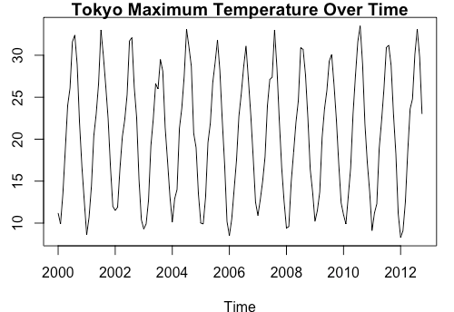
For Live Session
Since the data is the monthly maximum temperature over time, we can definitely see the seasonality (cyclic behavior) in the realization and fitting an ARUMA model would seem appropriate.

Slide 3
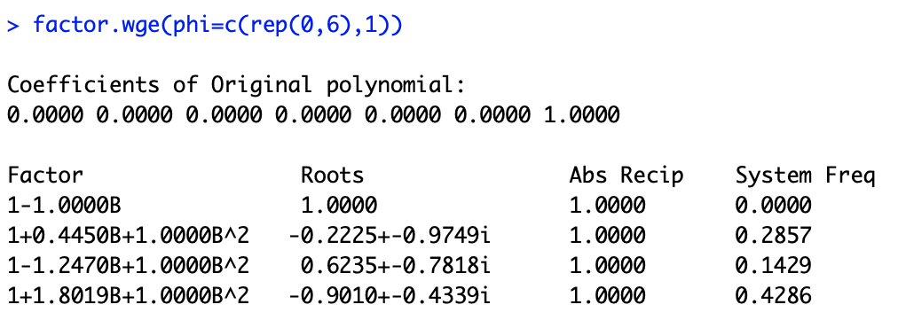
For Live Session
(1 – B⁷)

Slide 4
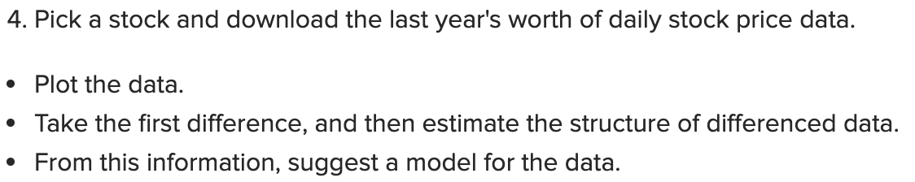
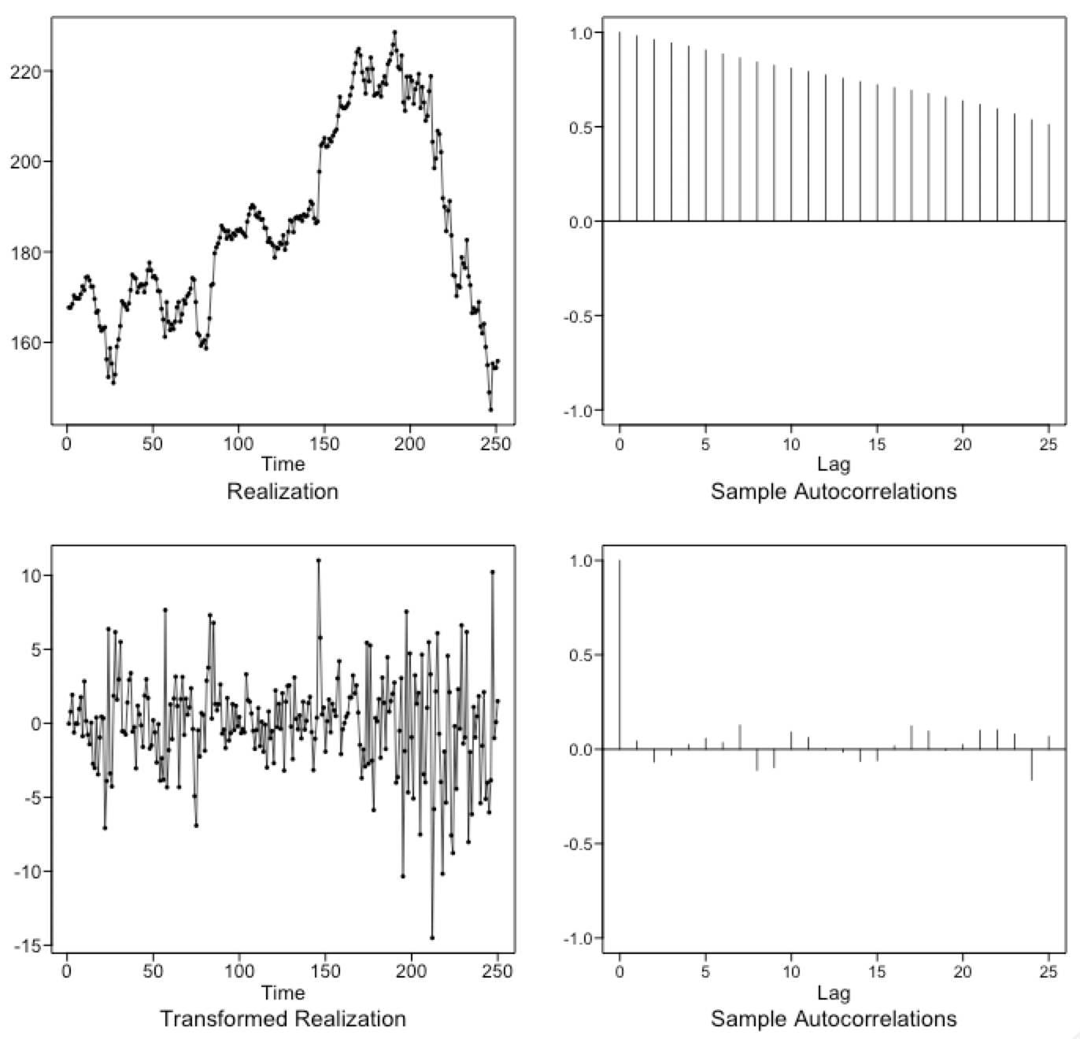
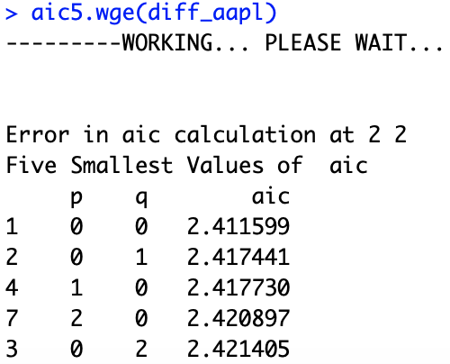
For Live Session
Apple Inc. Daily Adjusted Close Price from 2018
The differenced data suggests white noise. The use of aic5.wge() confirms it.
The stock data will be best fit with a signal plus noise model.

Slide 5
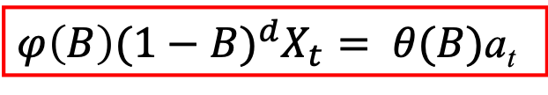
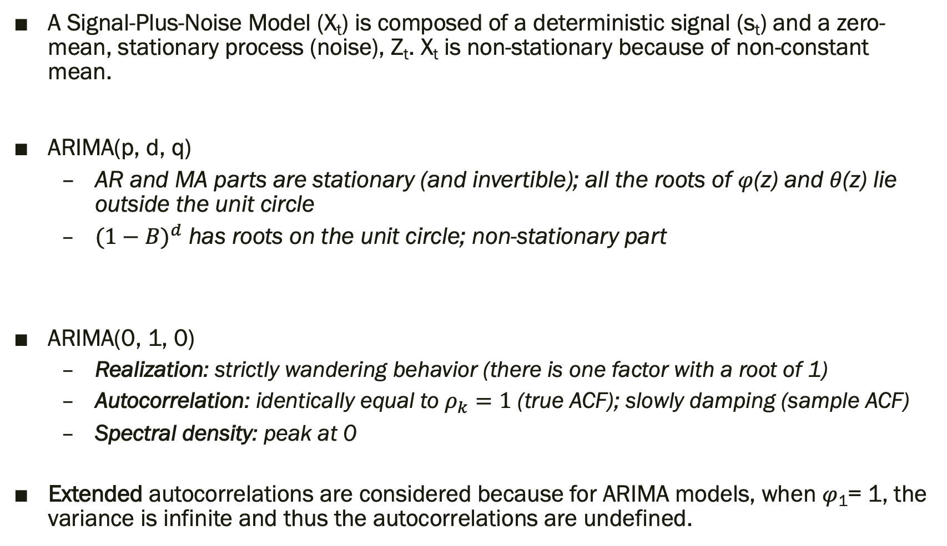
Key Takeaways
A Signal-Plus-Noise Model (X_{t}) is composed of a deterministic signal (s_{t}) and a zero-mean, stationary process (noise), Z_{t}. X_{t} is non-stationary because of non-constant mean.
ARIMA(p, d, q)
AR and MA parts are stationary (and invertible); all the roots of $φ$(z) and $θ$(z) lie outside the unit circle
${(1−B)}^{d}$ has roots on the unit circle; non-stationary part
ARIMA(0, 1, 0)
Realization: strictly wandering behavior (there is one factor with a root of 1)
Autocorrelation: identically equal to $ρ_{k}=1$ (true ACF); slowly damping (sample ACF)
Spectral density: peak at 0
Extended autocorrelations are considered because for ARIMA models, when $φ$₁= 1, the variance is infinite and thus the autocorrelations are undefined.
X _{t} = s_{t} + Z_{t}
$φ\left(B\right){(1−B)}^{d}X_{t}= θ(B)$a_{t}

Slide 6

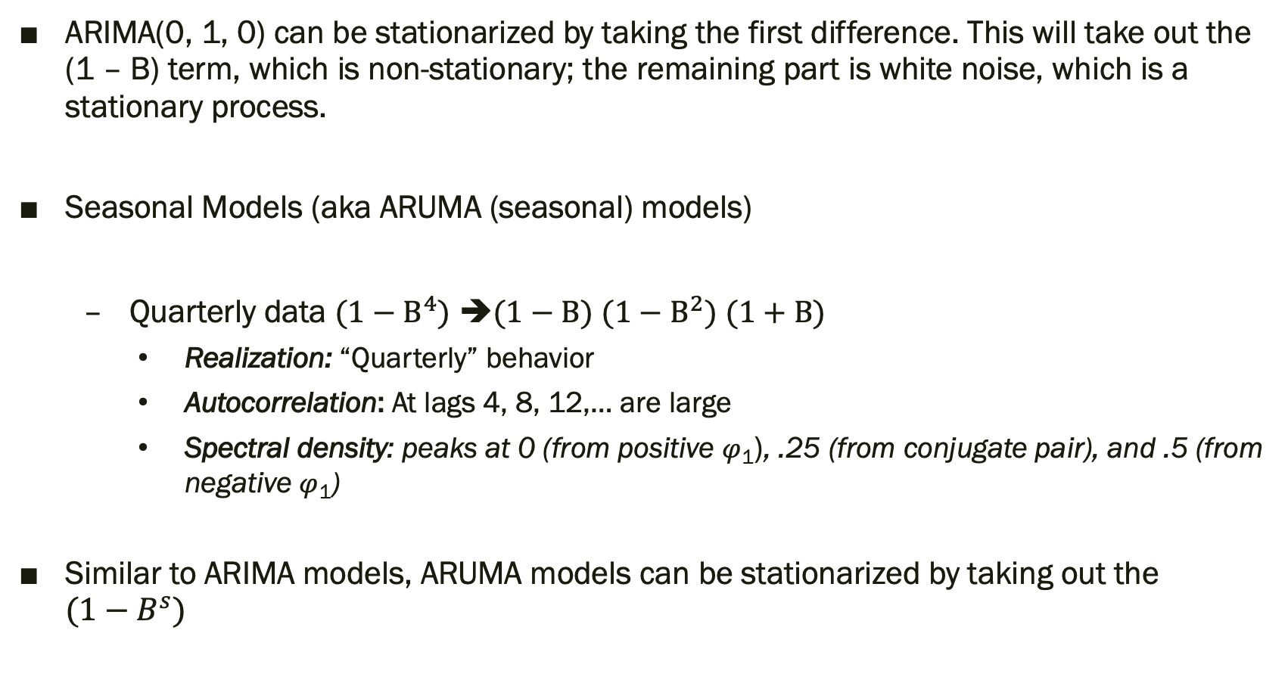
Key Takeaways
ARIMA(0, 1, 0) can be stationarized by taking the first difference. This will take out the (1 – B) term, which is non-stationary; the remaining part is white noise, which is a stationary process.
Seasonal Models (aka ARUMA (seasonal) models)
Quarterly data ${(1−B}^{4})$ ➔$(1−B)$ ${(1−B}^{2})$ $(1+B)$
Realization: “Quarterly” behavior
Autocorrelation: At lags 4, 8, 12,… are large
Spectral density: peaks at 0 (from positive $φ$₁), .25 (from conjugate pair), and .5 (from negative $φ$₁)
Similar to ARIMA models, ARUMA models can be stationarized by taking out the ${(1−B}^{s})$
$φ\left(B\right){(1−B}^{s})X_{t}= θ(B)$a_{t}

Slide 7
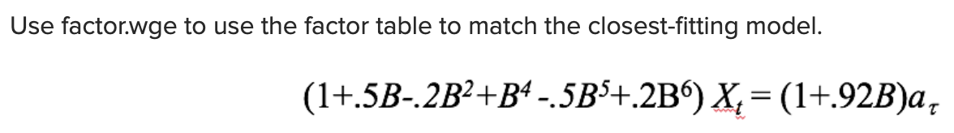
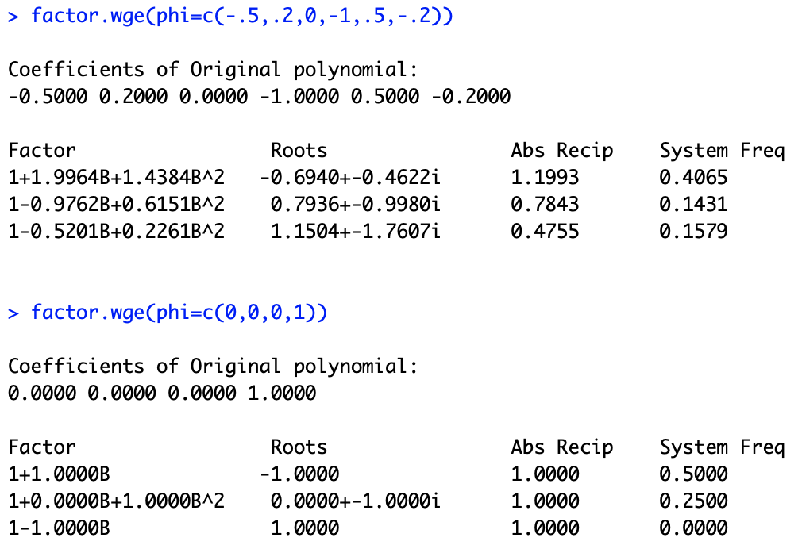
Question(s)
BLT 6.6(card 6):
I used the factor.wge on the AR part and got the factor table shown on the left. I also compared it to (1 – B⁴), but there is no similarity. How do you determine that a quarterly seasonality model can be used to model it and not the others? Or is there an error in the equation?

